Slide 1
Red Wine Quality Analysis
Exploratory Data Analysis & Machine Learning
Python
NumPy
Pandas
Matplotlib
Seaborn

Slide 2
1. Project Objective
Analyze the physicochemical properties of red wine.
Understand the factors associated with wine quality.
Perform data cleaning and exploratory data analysis (EDA).
Identify relationships, correlations, and potential outliers.
Prepare the dataset for machine learning based quality prediction.

Slide 3
2. Dataset Overview
1,599
Original Rows
12
Columns
0
Missing Values
240
Duplicate Values
Target variable : quality
Quality scores range from 3 to 8.
Features include acidity, sugar, chlorides, sulfur dioxide, density, pH, sulphates, and alcohol

Slide 4
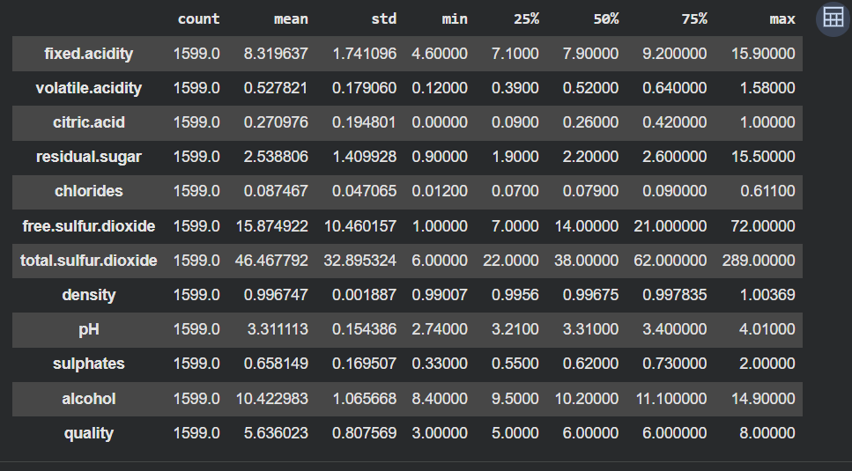
3. Data cleaning
Removed the unnecessary index column from the CSV file.
Identified 240 duplicate records.
Removed duplicates rows → 1,359 unique records remain.
Checked missing values and found no missing values after cleaning.
Verified data types and numerical columns before analysis.

Slide 5
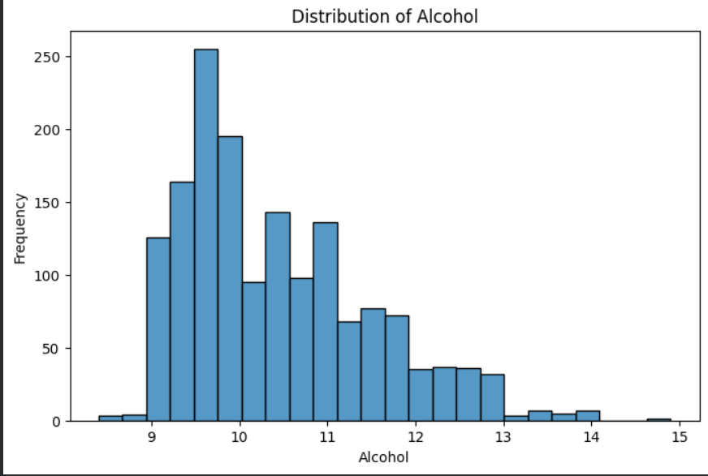
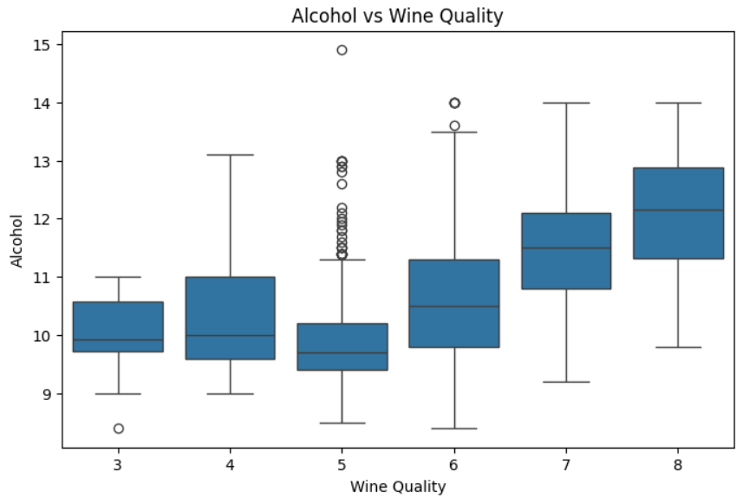
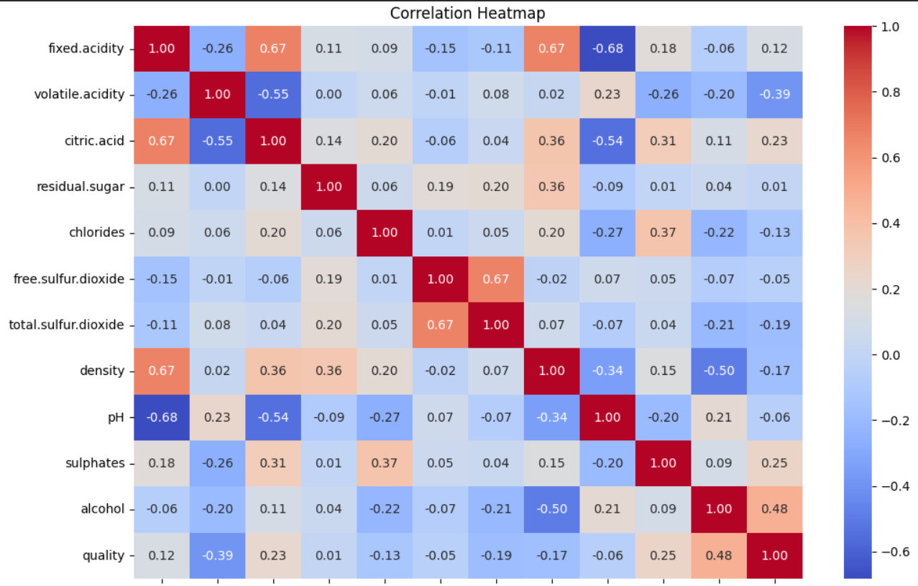
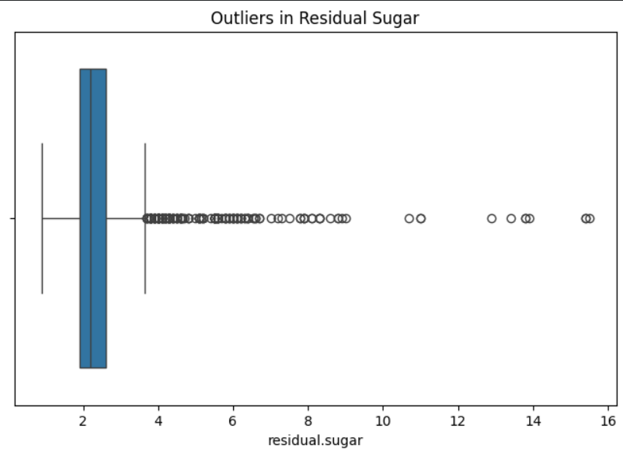
4. Exploratory Data Analysis
Univariate analysis: Distributions and boxplots for numerical variables.
Bivariate analysis: relationships between important features and quality.
Correlation analysis: measured linear relationships among numerical variables.
Outlier detection: used boxplots.
Target analysis: examined the distribution of wine quality scores.

Slide 6
5. Key eda findings
5.62
Average quality
10.43
Average alcohol;
3-8
Quality range
1.359
Clean records
Quality scores around 5 and 6 are more common than the extreme quality scores.
Alcohol shows a noticeable positive relationship with wine quality.
Volatile acidity generally shows a negative relationship with quality.
Several numerical variables contain potential outliers.

Slide 7
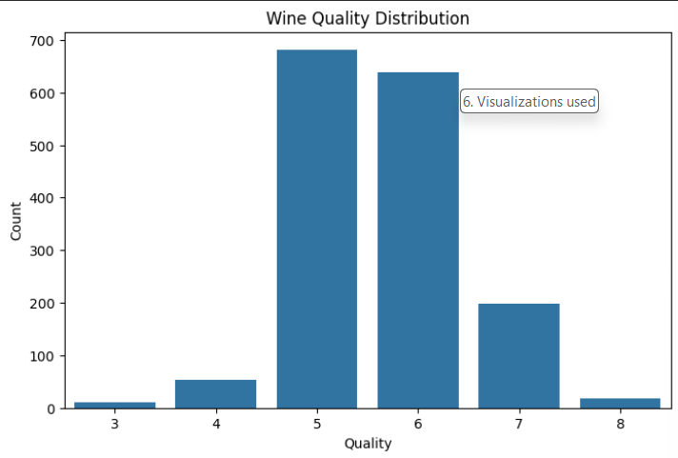
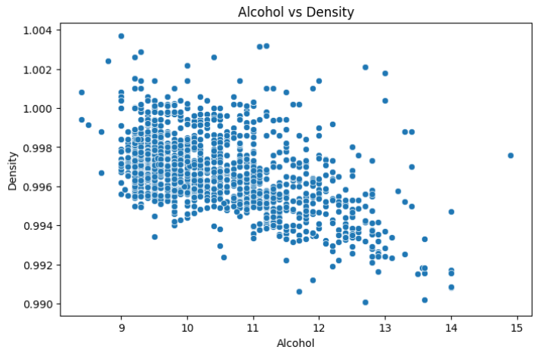
6. Visualizations used
Histogram – understand the distribution of numerical variables.
Count plot – understand the distribution of wine quality.
Box plot – compare numerical variables across quality levels and detect outliers.
Scatter plot – examine relationships such as alcohol vs. density.
Correlation heatmap – identify positive and negative relationships among features.

Slide 8
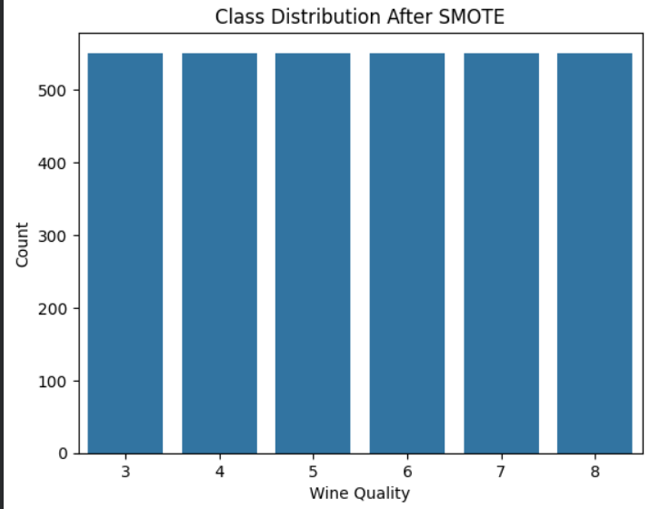
7. Machine learning approach
Target : quality
Split the cleaned dataset into 80% training and 20% testing data.
Applied SMOTE to the training data to address class imbalance.
Models: Logistic Regression and Random Forest Classifier.
Evaluation: accuracy, precision, recall, F1-score,and confusion matrix

Slide 9
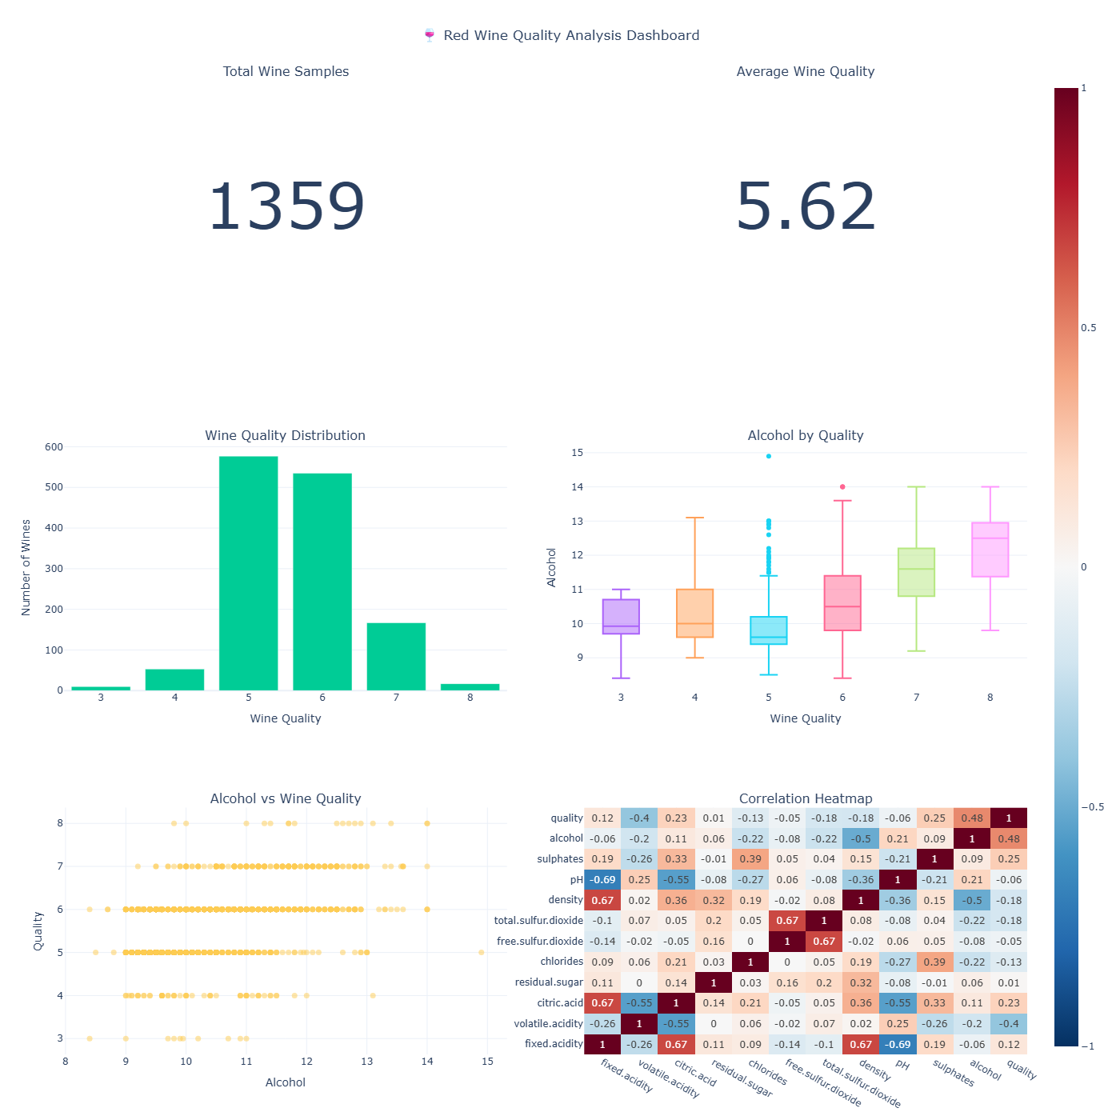
8. Final Analytics dashboard
KPI cards : total samples and average wine quality.
Wine quality distribution.
Alcohol distribution by quality.
Alcohol vs. quality relationship
Correlation heatmap.
Random Forest feature-importance analysis.

Slide 10
9. Final conclusion
EDA provided a clear understanding of the red wine dataset and its quality distribution.
Data cleaning removed duplicate records and prepared the dataset for modelling.
Alcohol and volatile acidity showed noticeable relationships with wine quality.
Correlation and visualization helped identify important patterns and potential outliers.
The cleaned dataset can be used for further model tuning and wine-quality prediction.

Slide 11
10. Tools & technologies
Google colab – development environment
Python – programming language
Pandas & NumPy – data handling and analysis
Matplotlib & Seaborn
Scikit-learn – machine learning and evaluation
Plotly – interactive dashboard

Slide 12
Thank You
Red Wine Quality Analysis

